Slide 1

Domestic Violence and Human Trafficking
Notes:
Introduce Yourself

Slide 2
NCCADV
Statewide membership organization serving all 100 NC counties and approximately 80 domestic violence organizations
North Carolina Coalition Against Domestic Violence

Slide 3
Four Branches of Work
Technical Assistance
Public Policy
Training
Programs
North Carolina Coalition Against Domestic Violence

Slide 4
NCCADV and Human Trafficking
Historically HT has lived with NCCASA
NCCADV received recent grant from DWY
Recent trainings for field emphasizing:
  Traffickers can be partners or family members
  Minors participating in commercial sex regardless of force, fraud, or coercion
  Unique safety planning considerations

Slide 5
Recent Polling
Before Training
How often do you serve survivors of Human Trafficking? | How of do you serve survivors of BOTH HT and DV?
56% a few times/year | 61% a few times/year
28% a few times/month | 33% a few times/month
6% multiple times/week | 6% multiple times/week
11% never | 0% never
North Carolina Coalition Against Domestic Violence

Slide 6
Recent Polling
Before Training
How often do you serve survivors of Human Trafficking? | How of do you serve survivors of BOTH HT and DV?
56% a few times/year | 61% a few times/year
28% a few times/month | 33% a few times/month
6% multiple times/week | 6% multiple times/week
11% never | 0% never
After Training
How often do you serve survivors of Human Trafficking? | How of do you serve survivors of BOTH HT and DV?
48% a few times/year | 43% a few times/year
38% a few times/month | 43% a few times/month
10% multiple times/week | 14% multiple times/week
5% never | 0% never
North Carolina Coalition Against Domestic Violence

Slide 7
Why does it matter that providers assess for human trafficking and not just domestic violence?
NORTH CAROLINA COALITION AGAINST DOMESTIC VIOLENCE
Notes:
HT survivors may need different things or be entitled to other resources. We can’t really safety plan accurately if we don’t understand the full picture.
T-visa:
Advantage to T-visa vs U-Visa is there are caps on both. Never reached the limit for T-visas in the decades program has existed. Wait time is substantially less (18 months-2 years).
Lawful T visa status for 4 years
Employment authorization
May provide pathway to lawful permanent residence
Can get benefits for derivatives (children, spouse, siblings, and parents depending on victim’s age)
Access to public benefits

Slide 8
Resources Available at DVSPs
Find your local Domestic
Violence Service Provider (DVSP)
Shelter Services
Court Advocacy
Safety Planning
Transportation funding
Rapid Rehousing funding
Support Groups
Counseling
Referral to other Resources

Slide 9
Caveats about DVSPs
Not all DVSPs have the same services
Not every county has their own DVSP
Some agencies serve multiple counties
If there is not an official agency, then survivors can still go to one of the closest ones for services
Very few DVSPs have dedicated HT staff
North Carolina Coalition Against Domestic Violence
Notes:
All DVSPs at least have hotline and basic advocacy/case management

Slide 10
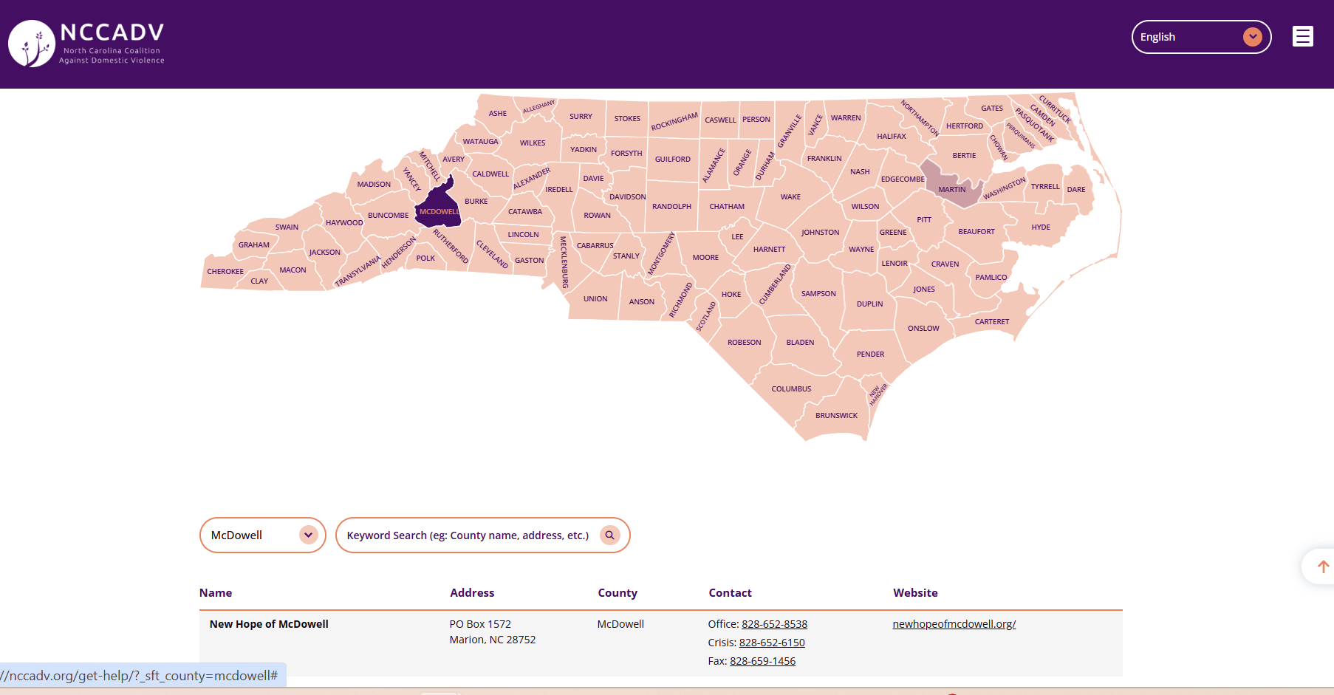
Finding Resources
You can find more information on the Get Help page on the NCCADV website
Link to Get Help
North Carolina Coalition Against Domestic Violence

Slide 11
CONTACT
Sarah Murray, Training Director
training@nccadv.org

